Slide 1

Electronic Thesis and Dissertation

Slide 2
Director – U Ravi Chhabra (Geo Mandalar Investment & Technology Co.,Ltd)
Supervisor – Dr. Ei Ei Mon
Present By – Ma Ei Po Po Aung (Test & Documentation2)
Ma April Su (UI/UX dev1)
Ma Myo Myo (Dev2)
Ma Htet Htet Htun (Dev1)
Ma Su Sandi Myint Naing (Test & Documentation1)
Ma Shun Lei Nadi Moe(UI/UX dev2)

Slide 3
Acknowledgement
First of all, we would like to express our very great appreciation to U Kyaw Zwa Soe, Rector of Computer University (Mdy).
We also greatly thank to Dr. San San Tint, Pro-Rector of Computer University (Mdy).
We also greatly thank to our teacher Dr. Mya Thida Kyaw, Head of faculty of Information Science.
And sincerely thank to our teacher Dr. Aye Aye Chaw, Head of faculty of Computer Science.
We also deeply thank to our director U Ravi Chhabra, CEO of GMIT, for his patient training to gain experience in modern software development and trust to give us.
And then greatly thank to our supervisor Dr. Ei Ei Mon, Associate Professor of Computer University (Mandalay), for her valuable guidance and patient supervisor, presentation and correctness of the project.

Slide 4
Technology Internship & Industry Development Enterprise (TIIDE Internship Program)

Slide 5
Git basics - Setup Git, Initial Git, Commit, Merge, Branch. add/remove remotes
Github basics - Setup Repos. Import existing repo. Create new repo. Work with multiple remotes (origin, heroku etc)
VIM basics - Navigate VIM wih hjkl; Move in and out of VISUAL and INSERT modes; Master navigation commands;
Static Page on Github - Learn basic of setting up a github.io page. Fork a Personal Page and turn this into personal profile page on github.io
Python Practice - Complete Learn Python The Hardway
HTML Practice - Basic HTML and HTML5, Basic CSS on FreeCodeCamp
Heroku Basics - Delply, Debug and Log on Heroku
JavaScript Practice - Basic JavaScript on FreeCodeCamp
Front End development - UIs with Materializecss + MDL and KnockOutJS. Design Screenflows with InvisionApp
Firebase Basics - Setup basic hosting with Firebase. Use realtime database to store and retreive data. Basic CRUD on Firebase
Python Flask Heroku - Flask basics: Routing, Jinja Template. Database with SQLAlchemy. RESTful API
Data Binding - Use KnockOutJS to bind data.
Electronic Thesis and Dissertation - Use Firebase to develop an Electric Thesis and Disseration App using the toolsets and workflow covered in the internship program.

Slide 6
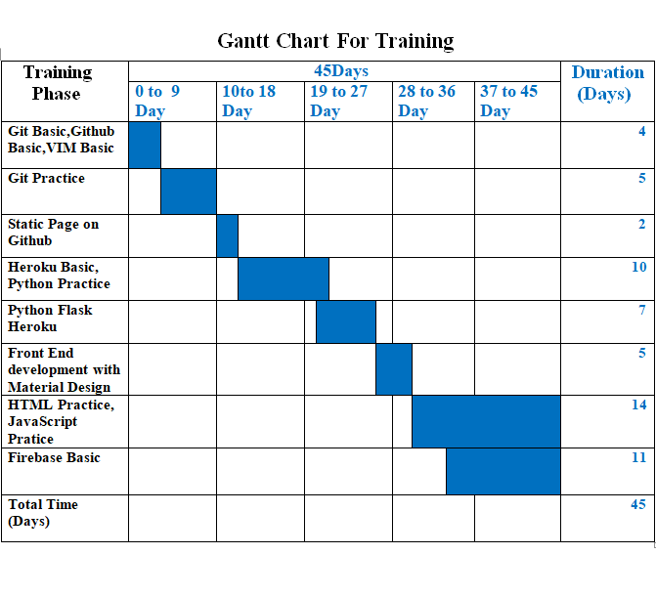

Slide 7
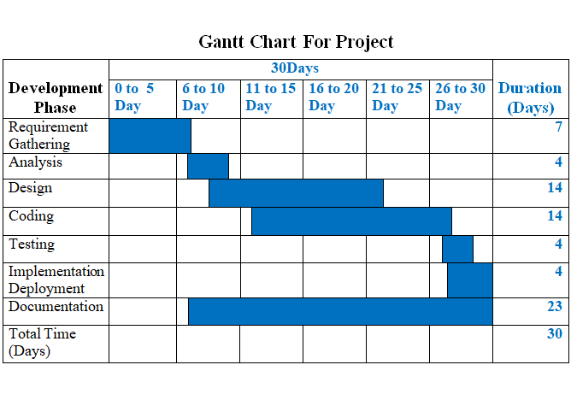

Slide 8
Abstract
Electronic Thesis and Dissertation System is a work submitted in support of candidature for a doctorate or master’s degree.
Electronic version of theses and dissertations are called ETDs.
This system is kind of Education website.
In our system , users can search theses and dissertations of CU (Mdy) by Year, and can see abstract of the thesis, author name, supervisor name and the major.
Users can also search books and theses of Otago University and Global ETD for more references.
For admin Panel, admins can insert data into database, delete and retrieve data for database.
Users can use our system with both smart phones and computers.
For Front End, the system was implemented using material design (HTML, CSS).
For Back End, this system was implemented using javascript and jQuery. And we also used Firebase Hosting and Database.

Slide 9
Objectives
To save time for finding thesis guideline and thesis information
To help students to be better prepared as knowledge workers
To develop university digital library services and infrastructure
To increase sharing and collaboration among university and students
To enhance access to university research
To reduce paper work

Slide 10
Introduction
Nowadays, modern technologies are sharply developed. And most of the people widely use the internet with mobile phones and computers for various purposes. Most of the universities around the world use online libraries. In that libraries, students can search books at every time and everywhere. It can save time and energy.
Our project ETD (Electronic thesis and dissertation), it mainly focuses to search easily theses and dissertations of Computer University (Mdy) at one place. In our project, students can search theses with their abstracts from 2008 to 2016.
In our ETD project, students can also search theses reference books and global theses and dissertations from other universities around the world for various fields and majors.
The aim of our ETD project is to save time and energy, to reduce paper works and familiar with electronic library.

Slide 11
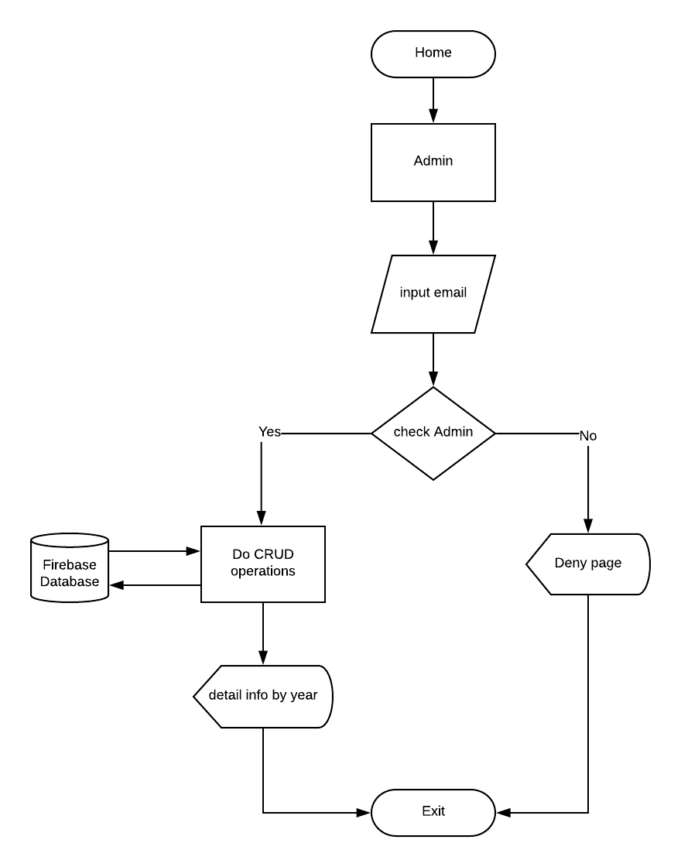
Project Development
Flow Chart for Admin

Slide 12
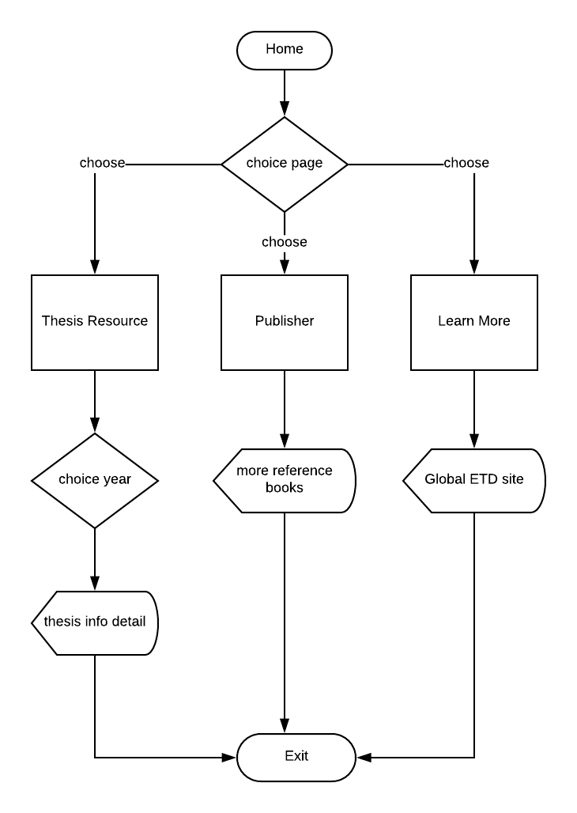
Flow Chart For User

Slide 13
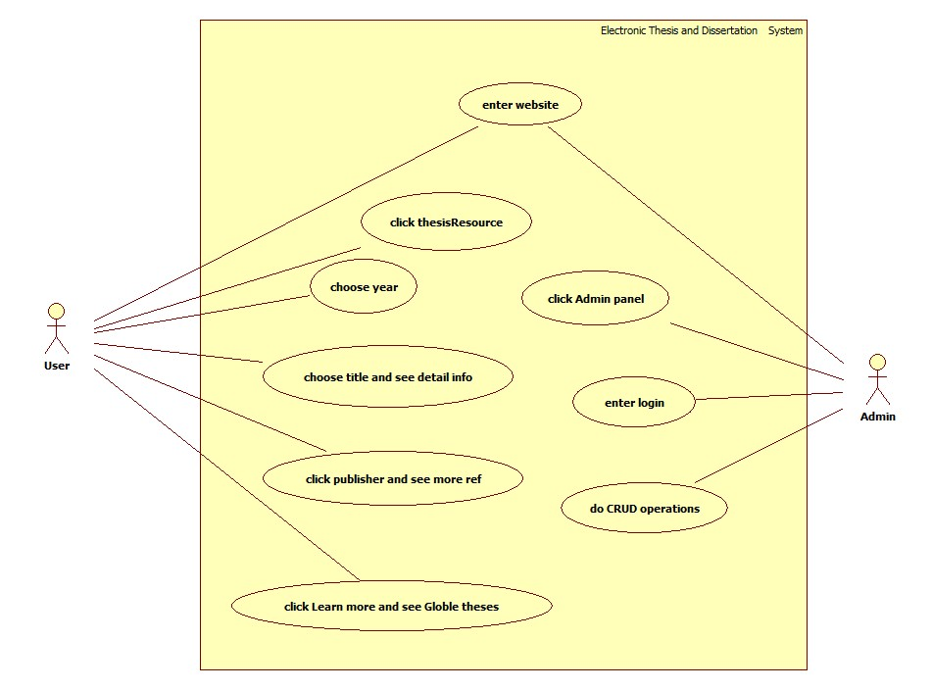
Usecase Diagram for Electronic Thesis and Dissertation System

Slide 14
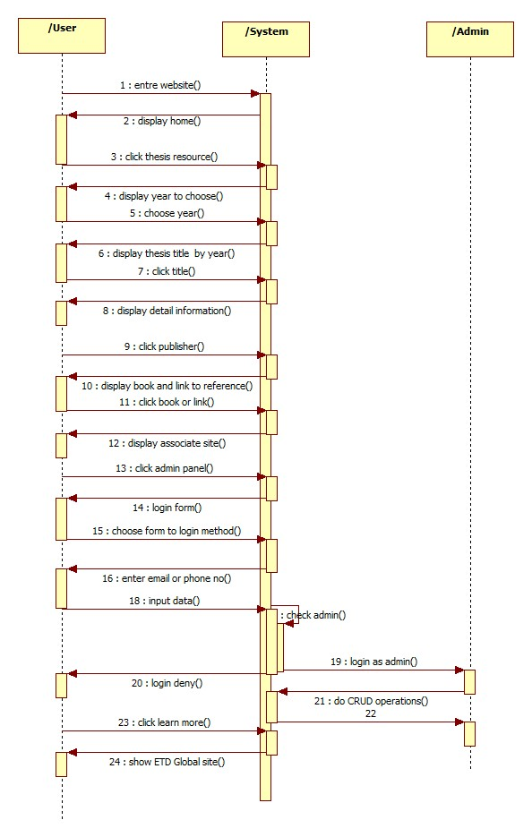
Sequence Diagram for Electronic and Dissertation System

Slide 15
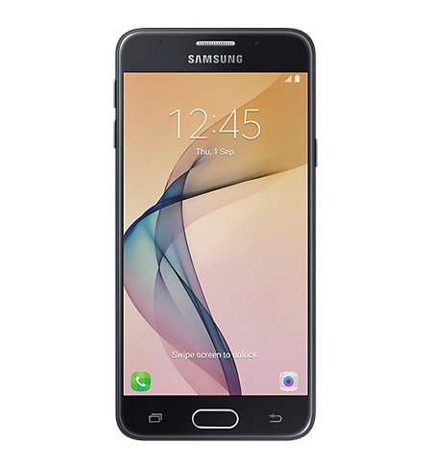
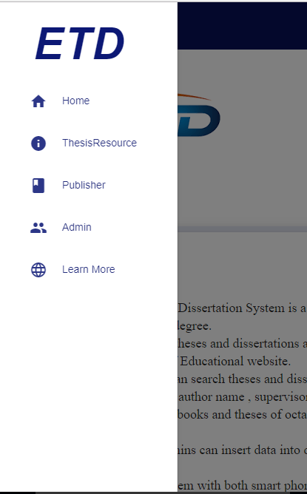
ETD Functions
In this system, we use navigation bar. When users click navigation bar, users can see Home, ThesisResource , Publisher, Admin and Learn More.

Slide 16
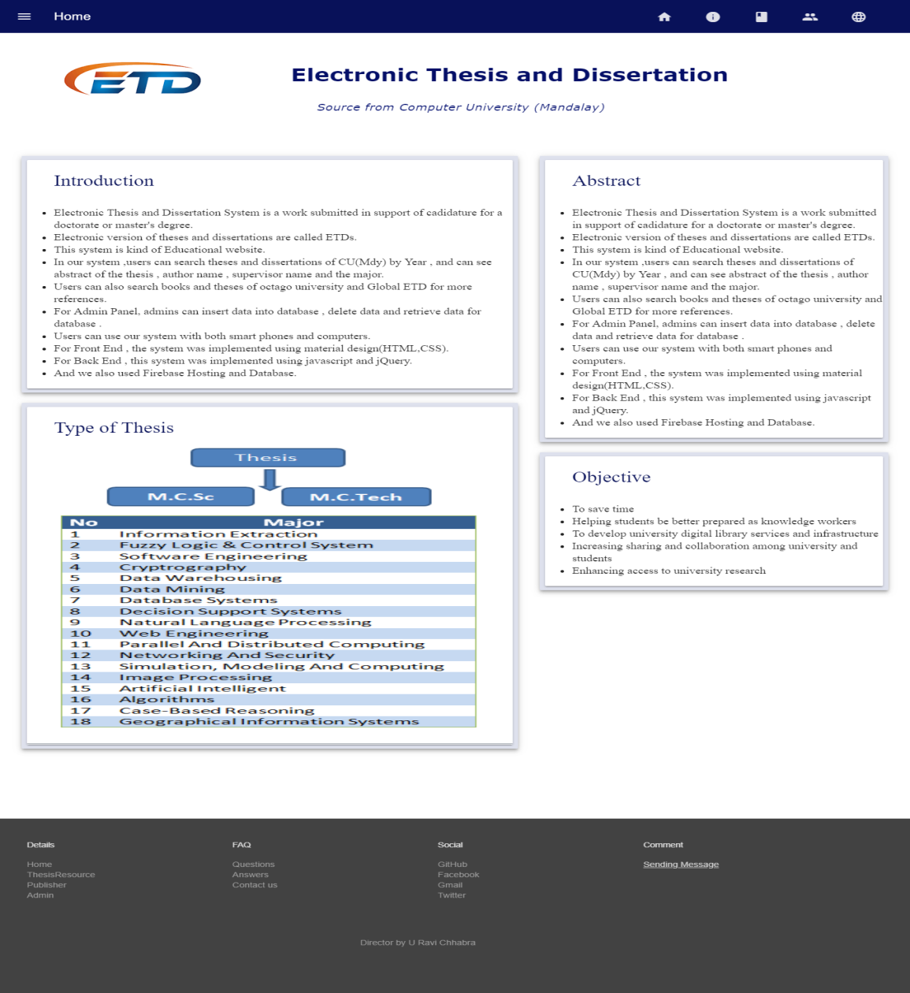
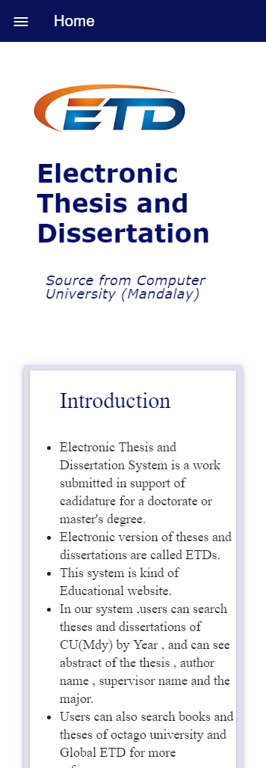
In Home Page form, we can see Introduction, Type of Thesis, abstract, and objective.

Slide 17
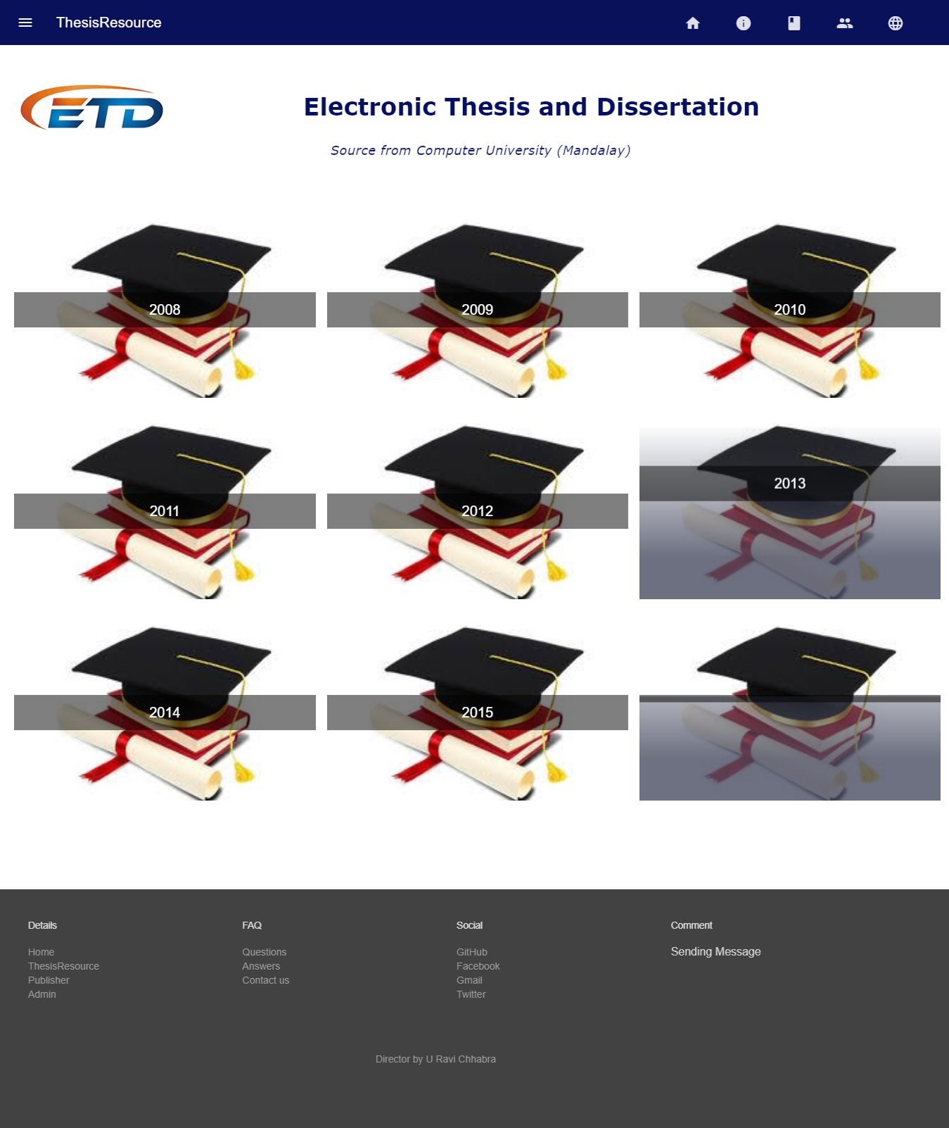

In the following form, users can see theses resources by year from 2008 to 2016.

Slide 18
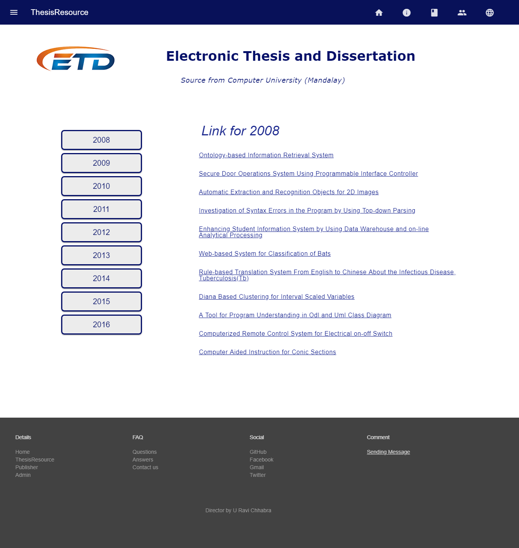
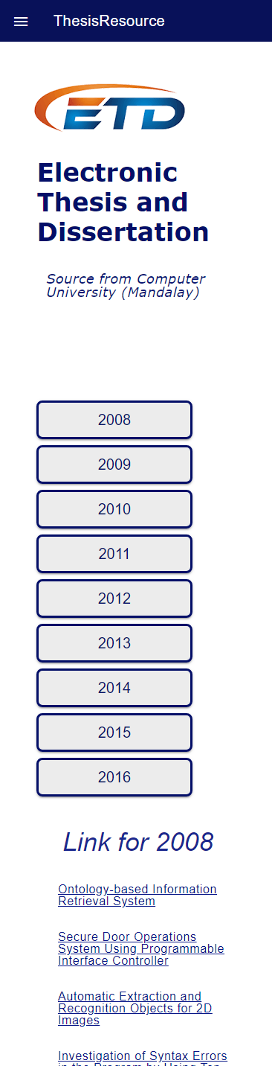
If user clicks 2008, user can see thesis titles in 2008.

Slide 19
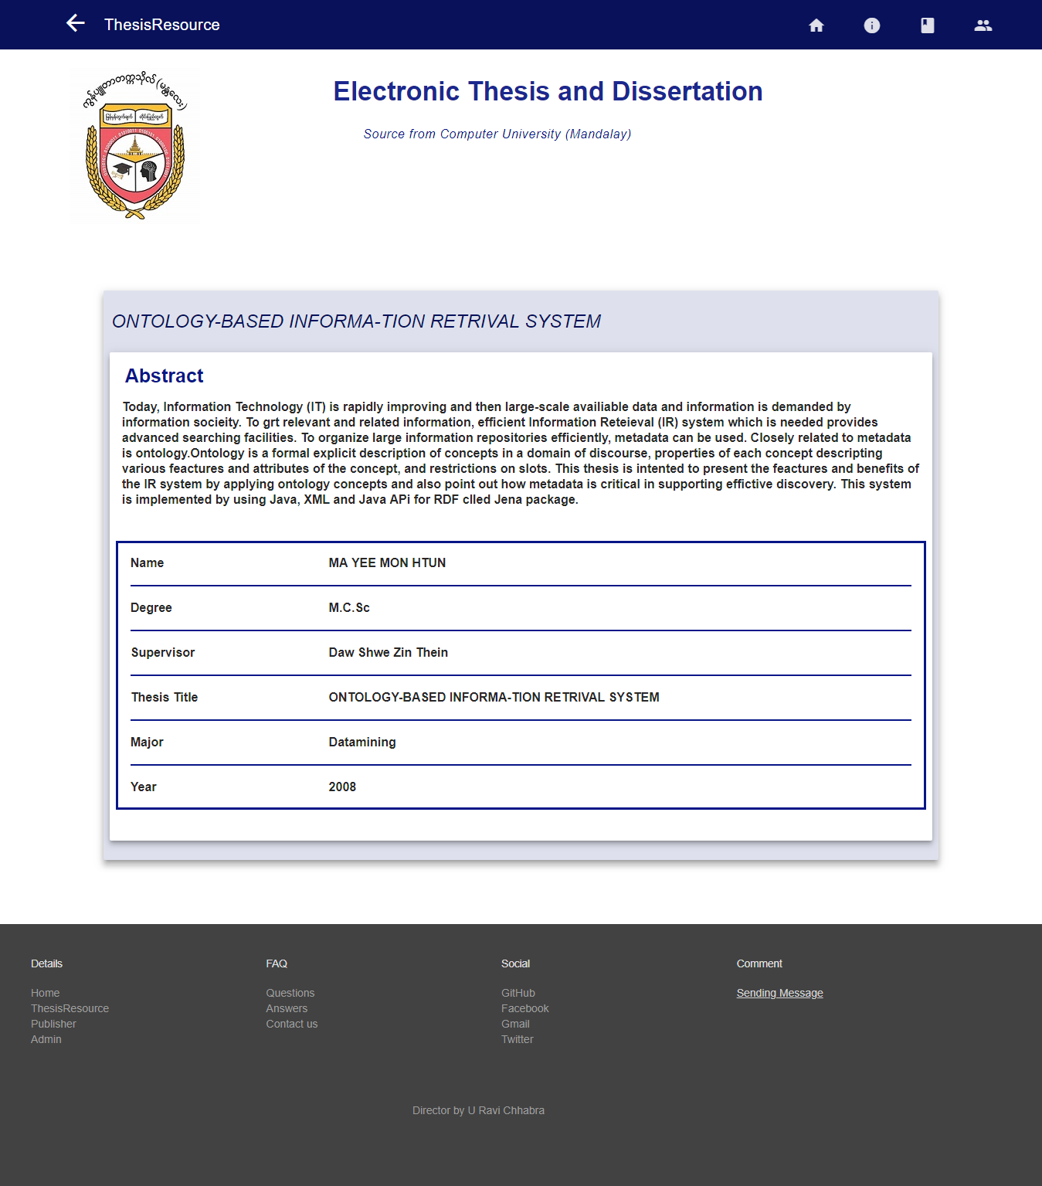
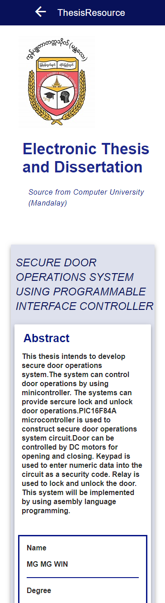
When user clicks thesis title, user can see the following form. There are Abstract of thesis, Author’s Name, Degree, Supervisor, Thesis Title, Major and Year.

Slide 20
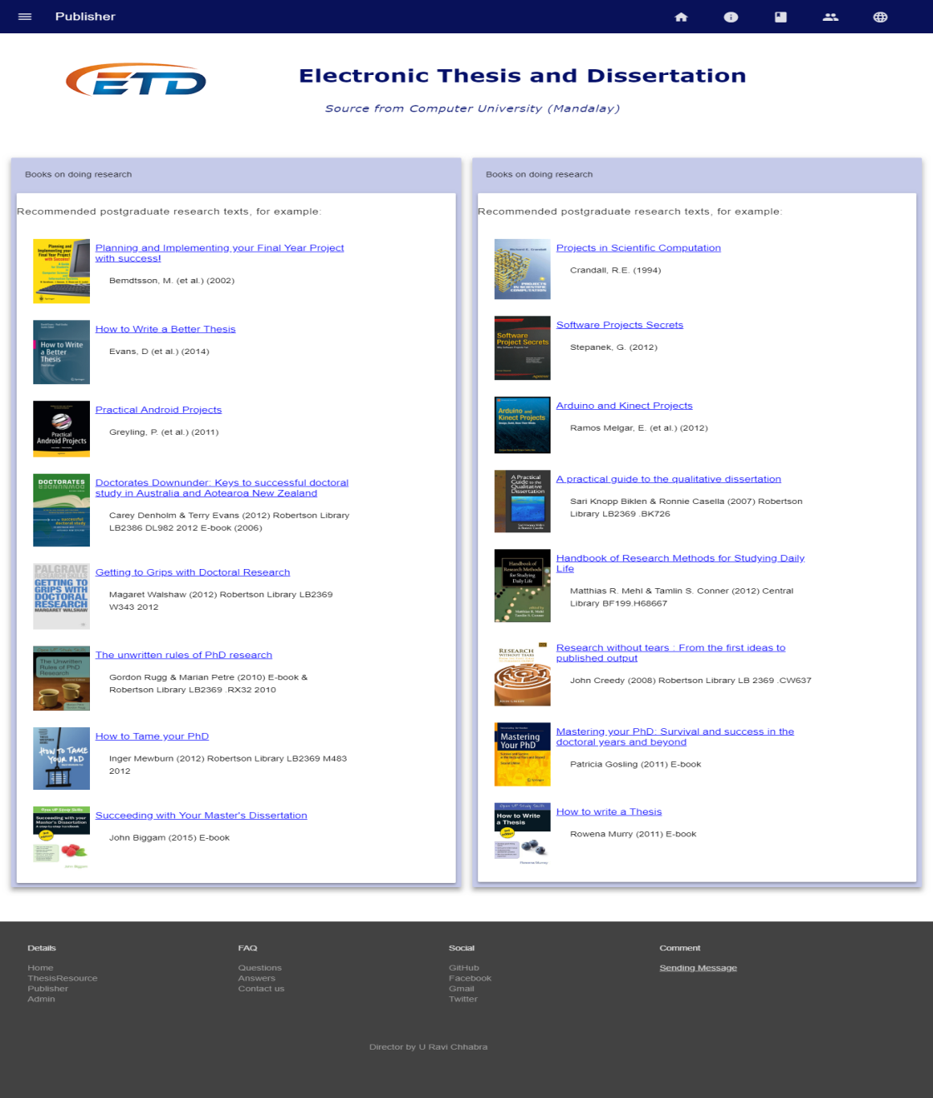
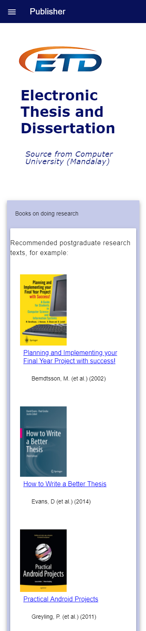
If user click ‘Publisher’ , user can see e-books for more reference.

Slide 21
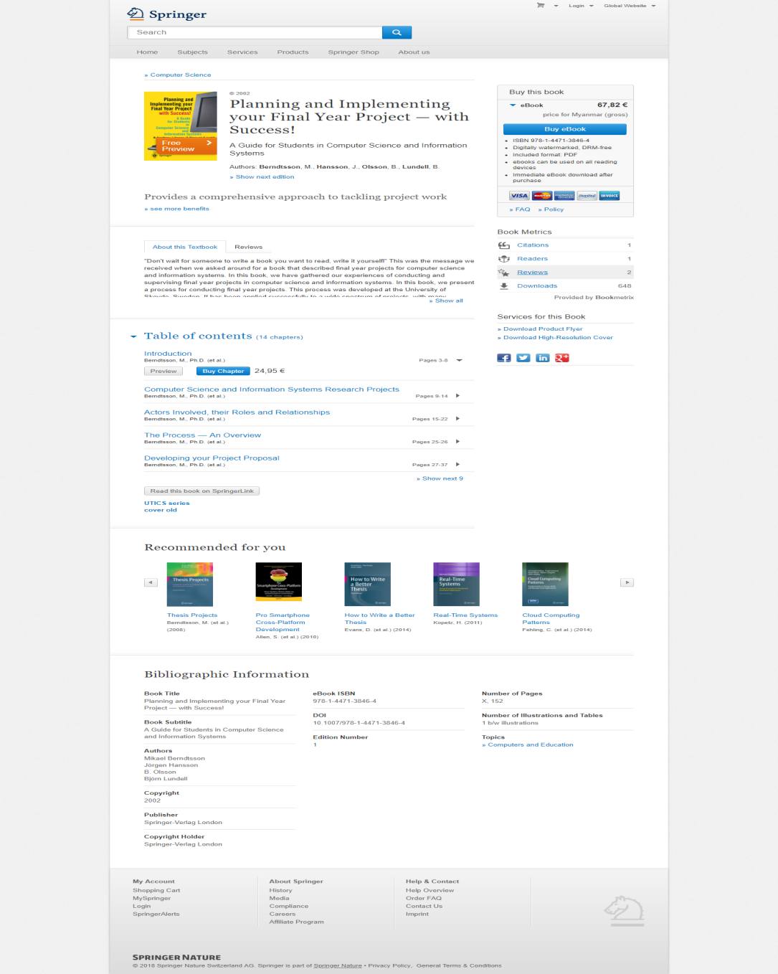
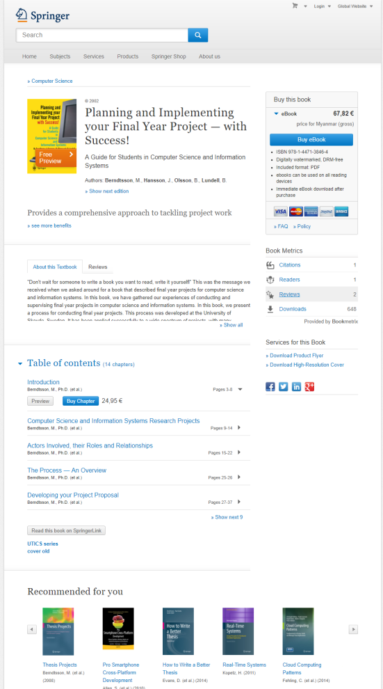
When user clicks any title of e-books, user can see the detail information of the title that user click.

Slide 22
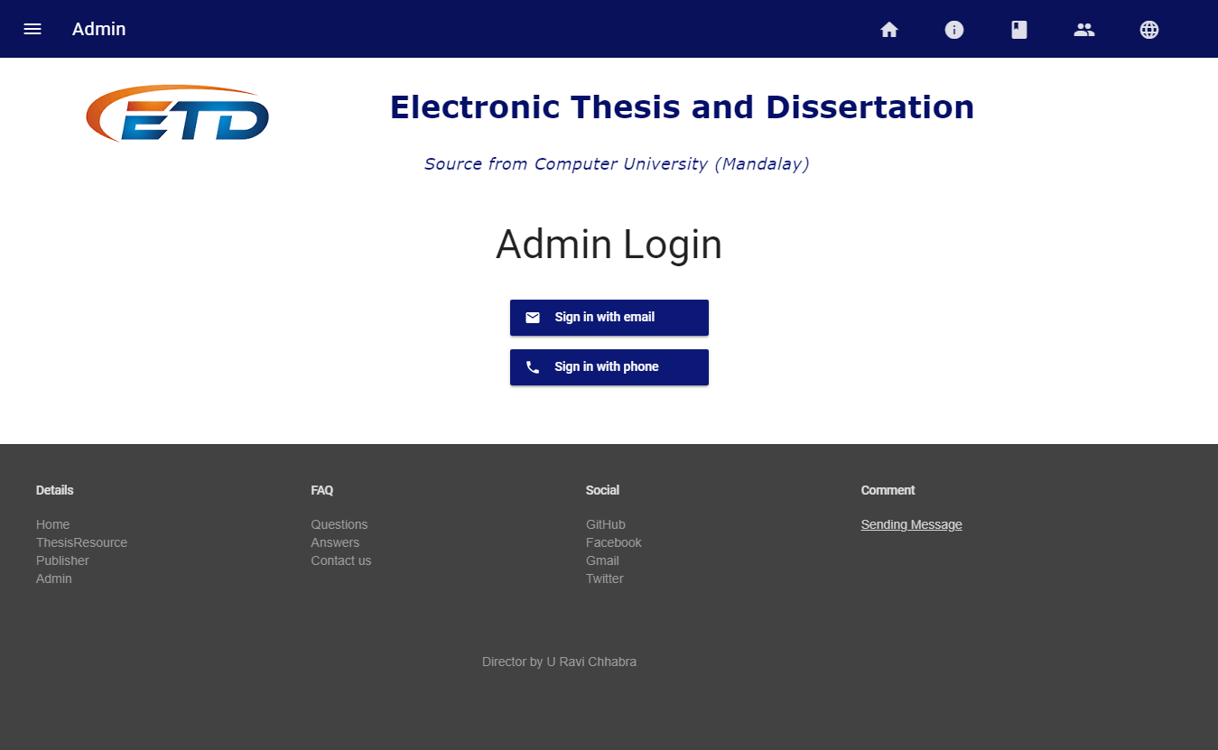
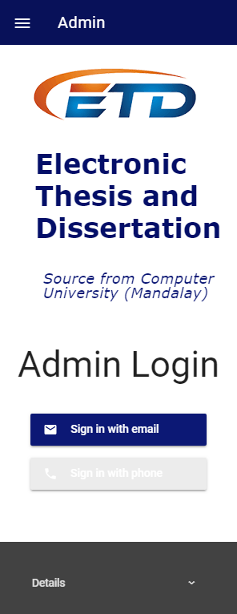
Admin can login with two ways – email and phone number.

Slide 23
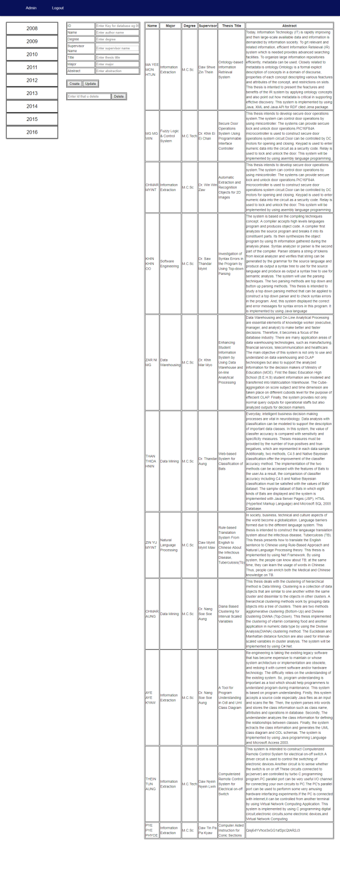
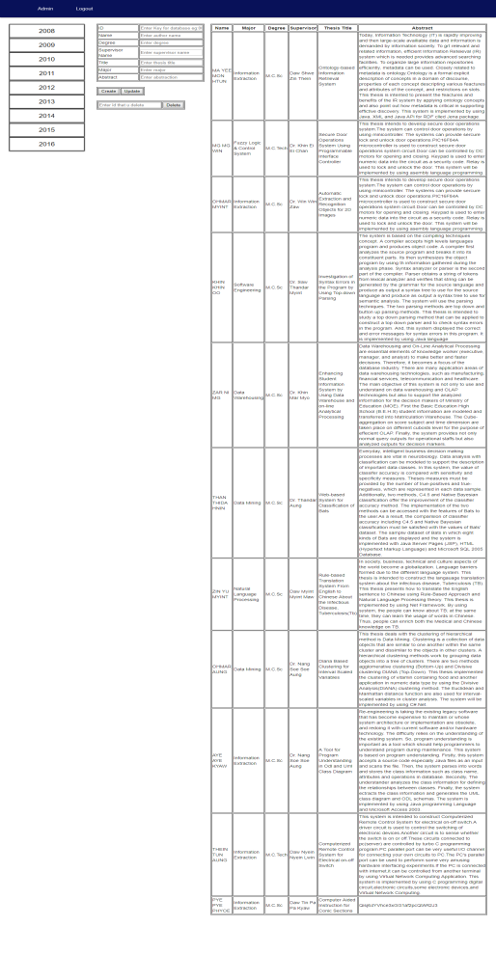
In Admin Panel , admin can do CRUD operations – Create, Retrieve, Update, Delete

Slide 24
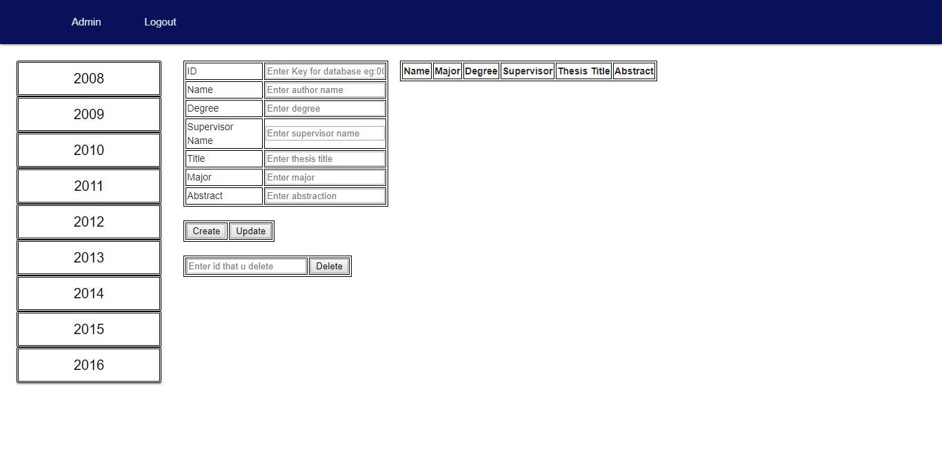
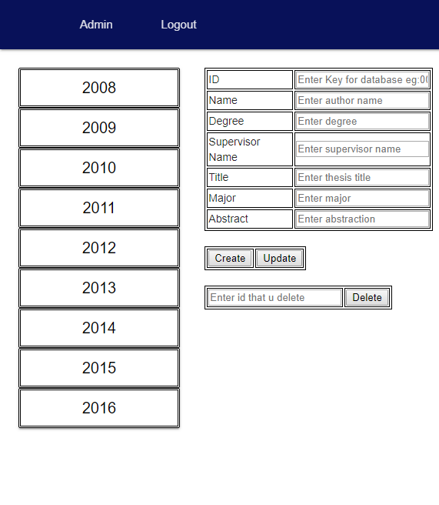
When invalid user login to admin panel , invalid user can see the form but can’t see any data and changes.

Slide 25
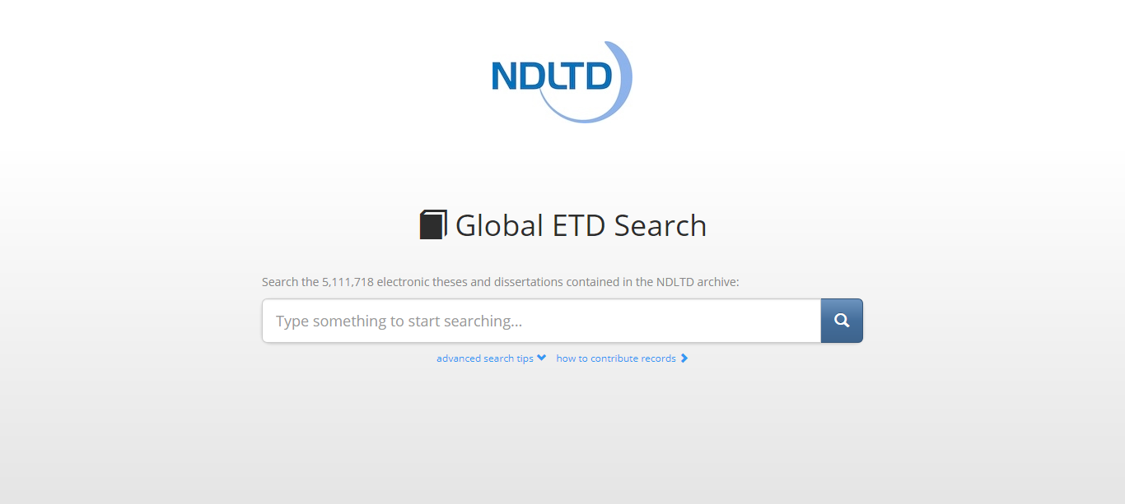
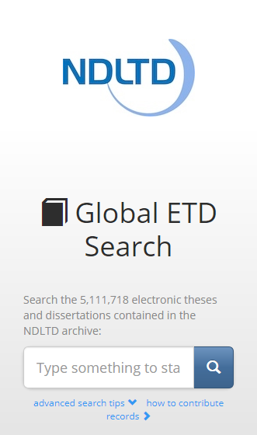
In the below form, user can search Theses in global and it combines with 5,111,718 electronic theses and dissertations where can find any fields that you want .

Slide 26
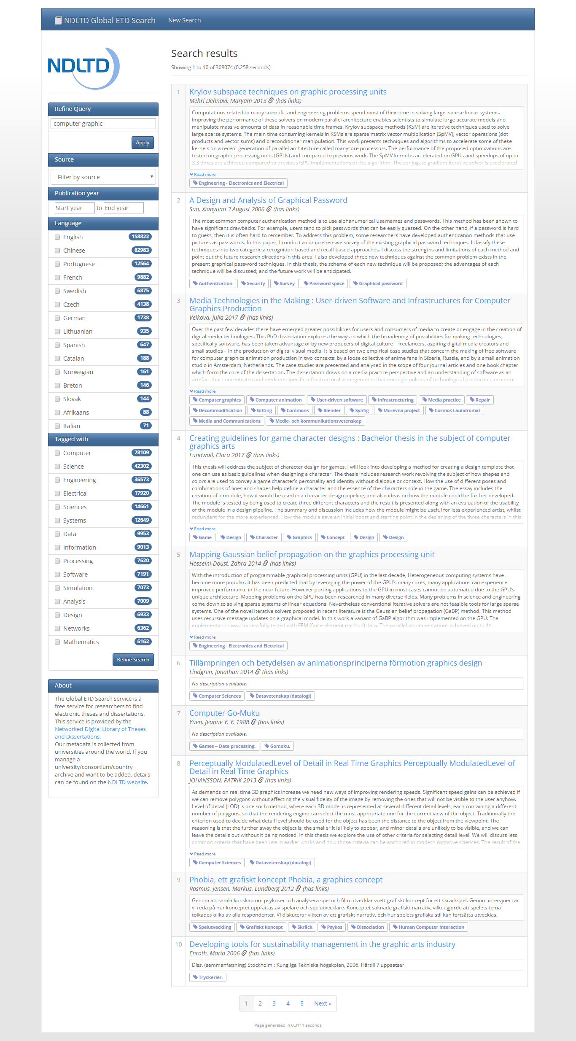
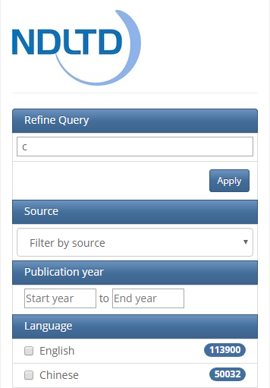
In Global ETD Search, user can see like this.

Slide 27
What is firebase?
Firebase is a platform that makes developing android apps or web app easier.
It is owned by Google and is easy to Integrate to projects
It combines Database, Authentication, Storage, Hosting etc.
Database – store data as a tree
Authentication - Use firebase as a database to manage users
Hosting – Offer lightweight configuration options for building web apps. We can easily rewrite URLs for client-side routing or set up custom headers.
Storage - Store data by using firebase as backend such as images

Slide 28
Database Implementation
We used Firebase Database in our ETD project.
Firebase Database is No-SQL Database and No-Relational Database (No tables)
It works as a tree.
Data are inserted in the database as a child node.

Slide 29
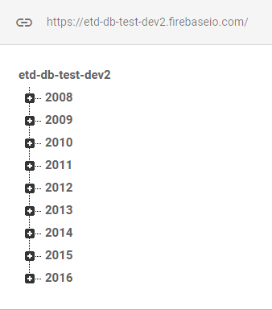
Database name is etd-db-test-dev2 and (2008, 2009, 2010, 2011, 2012, 2013, 2014, 2015, 2016) are its child nodes.
Database name
Child nodes

Slide 30
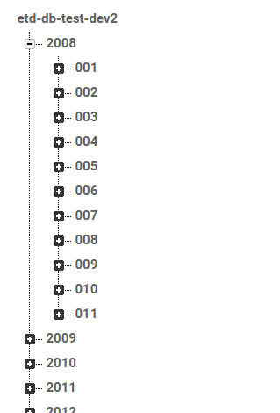
Database can also insert as sub child nodes.
parent
Sub parent node
Child nodes

Slide 31
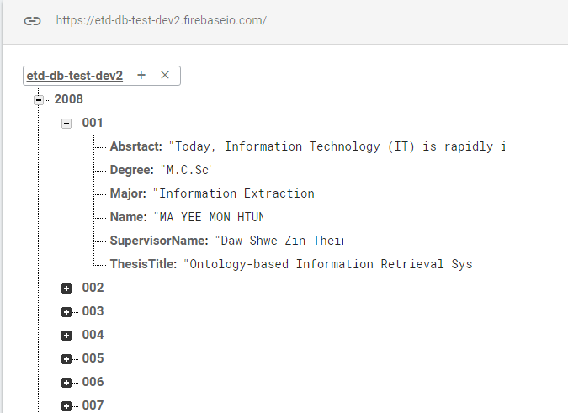
Sub parent
Child nodes

Slide 32
Conclusion
This system provides users to search easily CU (Mdy) theses from 2008-2016 with abstract.
At admin panel, admin can create, retrieve, update and delete data from firebase database. And also do permissions for login users.
Our project has a weakness.
It doesn’t show full data of all thesis because our data are collected from CU (Mdy) library and there is no soft copy of theses.
But we make our ETD system to find global theses and dissertations for more reference. Users can search 5,111,718 electronic theses and dissertations at Global ETD site where can find any fields that you want.
For our project future plan, we aim to do more useful site for our university. We want to make from ETD mini project to CU (Mdy) e-Library.

Slide 33
THANK YOU SO MUCH

